Slide 1
SSZG 518: Database Design and Applications
Today’s Class
Relational Model - Querying

Slide 2
Example Instances
R1
“Sailors” and “Reserves” relations for our examples.
S1
S2
Notes:
5

Slide 3
Projection
Deletes attributes that are not in projection list.
Schema of result contains exactly the fields in the projection list, with the same names that they had in the input relation.
Projection operator has to eliminate duplicates! Why?
Note: real systems typically don’t do duplicate elimination unless the user explicitly asks for it (by DISTINCT). Why not?
Notes:
7

Slide 4
Selection
Selects rows that satisfy selection condition.
No duplicates in result! Why?
Schema of result identical to schema of input relation.
What is Operator composition?
Selection is distributive over binary operators
Selection is commutative
Notes:
8

Slide 5
Union, Intersection, Set-Difference
All of these operations take two input relations, which must be union-compatible:
Same number of fields.
`Corresponding’ fields have the same type.
What is the schema of result?
Notes:
9

Slide 6
Banking Example
branch (branch_name, branch_city, assets)
customer (customer_name, customer_street, customer_city)
account (account_number, branch_name, balance)
loan (loan_number, branch_name, amount)
depositor (customer_name, account_number)
borrower (customer_name, loan_number)

Slide 7
Banking Example
branch (BN, BC, Assets)
customer (CN, CS, CC)
account (AN, BN, balance)
depositor (CN, AN)
loan (LN, BN, amount)
borrower (CN, LN)

Slide 8
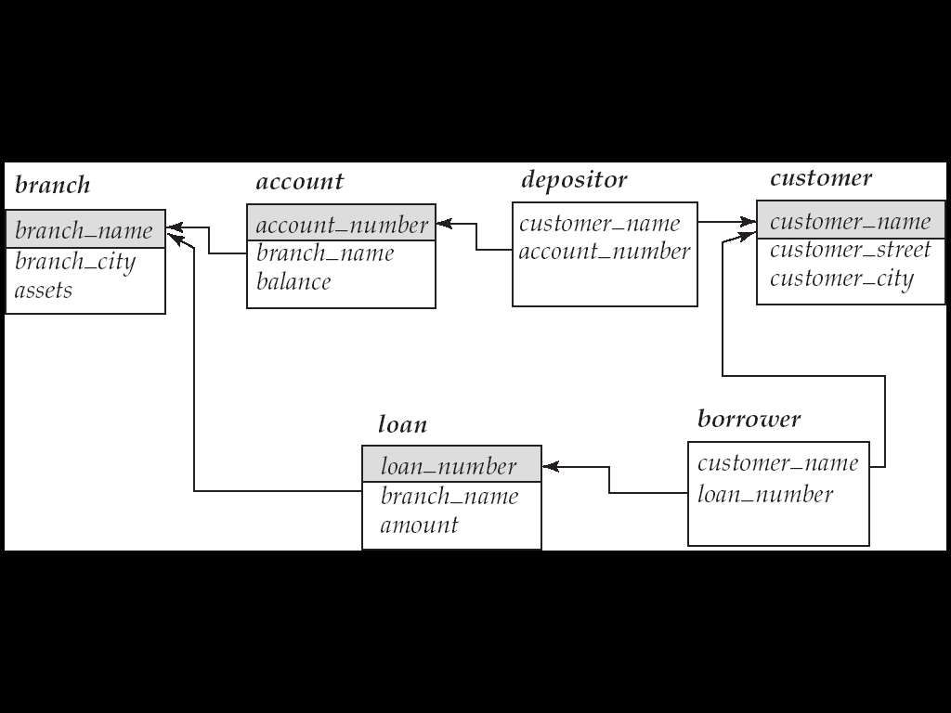
Example Queries
Find all loans of over $1200
σ_{amount > 1200} (loan)
Find the loan number for each loan of an amount greater than $1200
∏_{loan_number} (σ_{amount} _{> 1200} (loan))
Find the names of all customers who have a loan, an account, or both, from the bank
∏_{customer_name} (borrower) ∪ ∏_{customer_name} (depositor)

Slide 9
Find the names of all customers who have a loan at the Perryridge branch.
∏_{customer_name} (σ_{branch_name=“Perryridge”}
(σborrower.loan_number = loan.loan_number(borrower x loan)))
Find the names of all customers who have a loan at the Perryridge branch but do not have an account at any branch of the bank.
∏_{customer_name} (σ_{branch_name = “Perryridge}
(σborrower.loan_number = loan.loan_number(borrower x loan))) – ∏_{customer_name}(depositor)

Slide 10
Find the names of all customers who have a loan at the Perryridge branch.
∏_{customer_name} (σ_{branch_name = “Perryridge”} ( σborrower.loan_number = loan.loan_number (borrower x loan)))
∏_{customer_name}(σloan.loan_number = borrower.loan_number ( (σ_{branch_name = “Perryridge”} (loan)) x borrower))

Slide 11
Find the name of all customers who have a loan at the bank and the loan amount
∏customer_name, loan.loan_number, amount
(σborrower.loan_number = loan.loan_number(borrower x loan))
∏customer_name, loan_number, amount (borrower loan)

Slide 12
Bank Example Queries
Find the largest account balance
Strategy:
Find those balances that are not the largest
Rename account relation as d so that we can compare each account balance with all others
Use set difference to find those account balances that were not found in the earlier step.
The query is:
∏_{balance}(account) - ∏_{account.balance}
(σ_{account.balance < d.balance} (account x ρ_{d} (account)))

Slide 13
Division Operation
Notation r ÷ s
Suited to queries that include the phrase “for all”
Let r and s be relations on schemas R and S respectively where
R = (A₁, …, A_{m}, B₁, …, B_{n})
S = (B₁, …, B_{n})
The result of r ÷ s is a relation on schema
R – S = (A₁, …, A_{m}) such that
r ÷ s = { t | (t ∈ ∏ _{R-S}(r)) ∧ (∀ u ∈ s ( tu ∈ r )) }

Slide 14
Find all customers who have an account at all branches located in Brooklyn city.
∏_{customer-name, branch-name} (depositor account) ÷ ∏_{branch-name} (σ_{branch-city = “Brooklyn”} (branch))

Slide 15
Division Operation – Example 1
Relations r, s
A
B
α
α
α
β
γ
δ
δ
δ
∈
∈
β
1
2
3
1
1
1
3
4
6
1
2
B
A
r ÷ s
1
2
α
β
s
r

Slide 16
Division Operation – Example 2
Relations r, s
A
B
C
D
E
D
E
A
B
C
α
α
α
β
β
γ
γ
γ
a
a
a
a
a
a
a
a
α
γ
γ
γ
γ
γ
γ
β
a
a
b
a
b
a
b
b
1
1
1
1
3
1
1
1
a
b
1
1
r ÷ s
α
γ
a
a
γ
γ
s
r

Slide 17
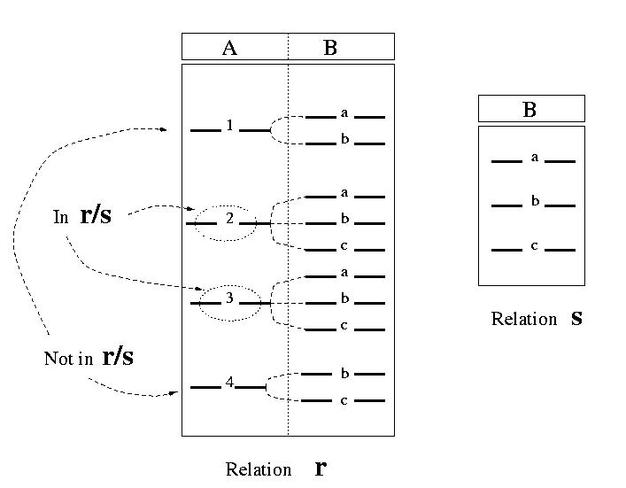
Division (con’t)

Slide 18
Properties of Division Operation
Let q = r ÷ s Then q is the largest relation satisfying: q × s ⊆ r
Relation r, s:
r
s
q

Slide 19
Theta Join
Condition Join:
Result schema same as that of cross-product.
Fewer tuples than cross-product, might be able to compute more efficiently
Sometimes called a theta-join.
Notes:
11

Slide 20
Joins
Equi-Join: A special case of condition join where the condition c contains only equalities.
Result schema similar to cross-product, but only one copy of fields for which equality is specified.
Natural Join: Equijoin on all common fields.
Notes:
12

Slide 21
Extended RA Operations
Generalized Projection
Outer Join
Aggregate Functions

Slide 22
Generalized Projection
Extends the projection operation by allowing arithmetic functions to be used in the projection list. ∏ _{F1, F2, …, Fn} (E)
E is any relational-algebra expression
Each of F₁, F₂, …, F_{n} are arithmetic expressions involving constants and attributes in the schema of E
Given relation credit-info(customer-name, limit, credit-balance), find how much more each person can spend
∏customer-name, limit – credit-balance (credit-info)

Slide 23
Aggregate Functions and Operations
Aggregation function takes a collection of values and returns a single value as a result.
Ex: Avg, Min, Max, Sum, Count
Aggregate operation in relational algebra
_{G1, G2, …, Gn} g _{F1( A1), F2( A2),…, Fn( An)} (E)
E is any relational-algebra expression
G₁, G₂ …, G_{n} is a list of attributes on which to group (can be empty)
Each F_{i} is an aggregate function
Each A_{i} is an attribute name

Slide 24
Aggregate Operation – Examples
Relation r
A
B
C
sum-C
α
α
β
β
α
β
β
β
7
7
3
10
g _{sum(c)} (r)
27

Slide 25
List all the branch names along with the total balance of all accounts
branch-name
account-number
balance
Perryridge
Perryridge
Brighton
Brighton
Redwood
A-102
A-201
A-217
A-215
A-222
400
900
750
750
700
_{branch-name} g _{sum(balance)} (account)
branch-name
balance
Perryridge
Brighton
Redwood
1300
1500
700

Slide 26
Result of aggregation does not have a name
Can use rename operation to give it a name
For convenience, we permit renaming as part of aggregate operation
_{branch-name} g _{sum(balance) as sum-balance} (account)

Slide 27
Null Values
It is possible for tuples to have a null value, denoted by null, for some of their attributes
null signifies an unknown value or that a value does not exist
The result of any arithmetic expression involving null is null
Aggregate functions simply ignore null values (except count(*))
For duplicate elimination and grouping, null is treated like any other value, and two nulls are assumed to be the same
We follow the semantics of SQL in its handling of null values

Slide 28
Outer Join
An extension of the join operation that avoids loss of information.
Computes the join and then adds tuples from one relation that does not match tuples in the other relation to the result of the join.
Uses null values:
null signifies that the value is unknown or does not exist

Slide 29
Outer Join – Example
loan-number
branch-name
amount
L-170
L-230
L-260
Downtown
Redwood
Perryridge
3000
4000
1700
Relation loan
customer-name
loan-number
Relation borrower
Jones
Smith
Hayes
L-170
L-230
L-155

Slide 30
loan-number
branch-name
amount
customer-name
Natural Join
loan Borrower
L-170
L-230
Downtown
Redwood
3000
4000
Jones
Smith
loan-number
branch-name
amount
customer-name
Left Outer Join
loan Borrower
L-170
L-230
L-260
Downtown
Redwood
Perryridge
3000
4000
1700
Jones
Smith
null

Slide 31
loan-number
branch-name
amount
customer-name
Right Outer Join
loan borrower
L-170
L-230
L-155
Downtown
Redwood
null
3000
4000
null
Jones
Smith
Hayes
loan-number
branch-name
amount
customer-name
Full Outer Join
L-170
L-230
L-260
L-155
Downtown
Redwood
Perryridge
null
3000
4000
1700
null
Jones
Smith
null
Hayes
loan borrower

Slide 32
Outer Join using Joins
Outer join can be expressed using basic operations
e.g. r s can be written as
(r s) U (r – ∏_{R}(r s) x {(null, …, null)}

